Slide 1


IEC61400-12-1 Ed 2 Collaboration
IEA Task 32 Round Robin & PCWG Worked Examples
NREL, Colorado, US
10th August 2016
IEC Task 32: Luke J Simmons (DNV GL) & David Schlipf (Stuttgart University)
PCWG: Peter Stuart (RES), Lee Cameron (RES) & Andrew Lawrence (RES)

Slide 2
IEC 61400-12-1 Status
Document Stage | Document Stage Description | IEC61400-12-1 Ed 2 Status
CDV Committee Draft for Voting | Feedback Stage: Document is sent to the various National Committees for comment. Once the feedback is received the TC (Technical Committee) integrated the feedback and prepares the FDIS. | Completed
FDIS Final Draft International Standard | Approval Stage: Document is sent to the National Committees for voting. At this stage no comments or requests for change are accepted although typographical errors can be pointed out for correction by IEC prior to publication. If, after the FDIS vote, the publication is approved, no more changes of a technical nature can be made to it. Only obvious editorial mistakes can be corrected. | Translation of FDIS to French presently in progress to be followed by issue of English/French FDIS to national committees for voting mid-August to October.
Publication of IS (International Standard) | Final Stage: The IEC generates the cover pages and prepares the document for publication. The document is published and put on sale in the IEC Web Store. Note that editorial errors not captured prior to publication can still be issued as corrigendum by IEC throughout the life of a specific publication. | Expected Late 2016/Early 2017
For a useful overview of the lifecycle of an IEC standard see http://www.iec.ch/standardsdev/resources/draftingpublications/overview/drafting_process/lifecycle.htm

Slide 3
IEC Task 32 & PCWG Collaboration Overview
The PCWG & IEA Task 32 are collaborating on a round robin exercise and associated set of spreadsheet worked examples.
IEC Task 32 is running a round robin on the application of IEC61400-12-1 Ed 2 using LiDAR data. The round robin will have particular focus on the uncertainty methodology of the new standard (informative Annex E).
The PCWG is seeking to develop a set of worked examples showing how to apply the uncertainty method defined in the new standard. Once complete these worked examples will serve as both an educational tool and as a benchmark for the PCWG analysis tool.
Expected Outcome: The combination of the round robin and supporting work examples are intended to build industry understanding and consensus of the new edition of IEC 61400-12-1.

Slide 4
Proposed Timeline (2016)
Round Robin (IEA Task 32)
Worked Examples (PCWG)
July and August: Distribute round robin dataset and instructions to registered participants.
01 September: Results due to be summarized and presented at PCWG meeting on 07 September in Pamplona
September: Present a summary of results and then investigate differences and identify clarifications to be provided in a second exercise, if justified.
October: Request second round robin be conducted, results due by end of month.
November: Collect final results, prepare summaries for PCWG meeting in Glasgow week of 12 December.
December: Presentation of final results at December PCWG meeting.
July & August: Preparation of work examples. Initial presentation of examples at August PCWG Meeting.
September: Preparation of full suite of worked examples at September PCWG Meeting. Release of worked examples on PCWG DropBox.
October & November: IEA32 & PCWG feedback on worked examples.
December: Public publication of work examples (ww.pcwg.org)

Slide 5
IEC Task 32 Round Robin: How to Participate?
Please register by sending an email to the IEA Task 32 Operating Agent Representative David Schlipf (IEAWind.Task32@ifb.uni-stuttgart.de).
Please state in your registration email:
Name and Institution, Member country
Stakeholder role (e.g. system developer, end user, lidar supplier, academic, …).
Do you intent to participate in the round robin and also attend the workshop?
Please register by the end of August 2016. Upon registration, the participants will receive a set of instructions for participating in the round robin. Participation in the round robin is not a commitment to attend the workshop. An invitation and details for the workshop will be provided at a later date.

Slide 6
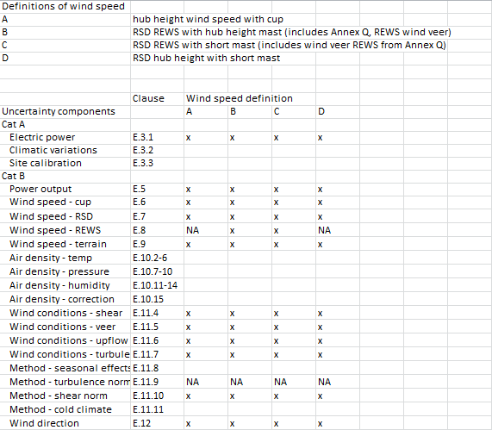
IEC Task 32 Round Robin: Analysis Pathways

Slide 7
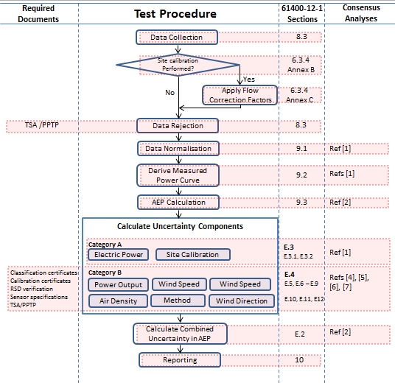
Worked Examples
Worked Example References: [1] Lawrence, A., (2016), Power Curve Measurement Using Method of Bins,
TC01-037758, Issue 01
[2] Lawrence, A., (2016), E.2 Combining Uncertainties
[3] Lawrence, A., (2016), E.3.1 Cat A Uncertainty in Electric Power
[4] Lawrence, A., (2016), E.13.2 Cat B Uncertainty in Electric Power
[5] Lawrence, A., (2016), E.13.3 Cat B Uncertainty in the wind speed measurement
[6] Lawrence, A., (2016), E.10 Cat B Uncertainty in Air Density
[7] Lawrence, A., (2016), E.13.15 Cat B Uncertainty for Method related components

Slide 8
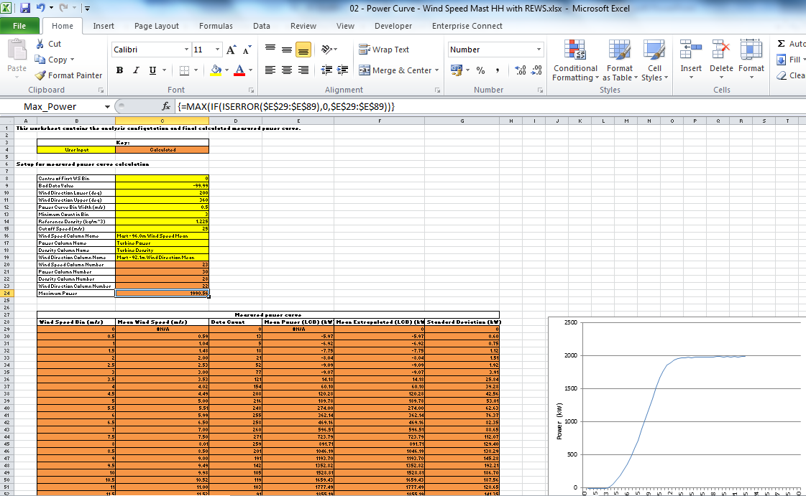
Worked Example: Power Curve Measurement Using Method of Bins

Slide 9
Questions?

